Slide 1
Unit 9
Solutions

Slide 2
Solubility Terminology
When a solution can have solute added and dissolved, the solution is unsaturated.
  Example: Lemonade with no or little sugar
When a solution cannot have solute added and dissolved, the solution is saturated
  Example: Lemonade with perfect amount of sugar
Super saturated solution is when a solution that contains more of the dissolved material than could be dissolved by the solvent under normal circumstances.
  Can have some of the solute fall out of the solution and form crystals
  Examples: Lemonade with solid sugar left at the bottom of the picture.

Slide 3
Types of solutions
Concentration of a solution is a measure of the amount of solute that is dissolved in a given quantity of solvent.
  Solute substance being dissolved
  Solvent substance doing the dissolving
  Lemonade solution, solute is lemon juice and sugar, solvent is water.
Dilute solution is on that contains a small amount of solute
Concentrated solution contains a large amount of solute
  1 g NaCl per 100 g H₂O would be dilute when compared to 30 g NaCl per 100 g H₂O (a concentrated solution)

Slide 4
Factors that affect rate of dissolving
Three factors affect the rate that a solid substance will dissolve in a liquid solvent
Agitation, temperature and particle size
  Agitation or stirring a solution will make the crystals dissolve more quickly
  increasing the temperature will increase the rate at which the substance will dissolve.
  Smaller particles (more surface area) dissolve much quicker.
  Remember: crush it, heat it, stir it

Slide 5
Factors that affect rate of dissolving
Three factors affect the rate that a Gas substance will dissolve in a liquid solvent
Agitation, pressure and temperature
  gasses dissolved in a liquid decreasing the temperature will allow an increase in the amount of gasses that can be dissolved
  Also increasing the pressure will increase the amount of gas that can dissolve in a liquid.
  NOT agitating (no stirring or shaking) will increase the amount of gas a liquid can hold.

Slide 6
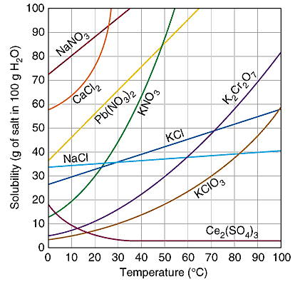
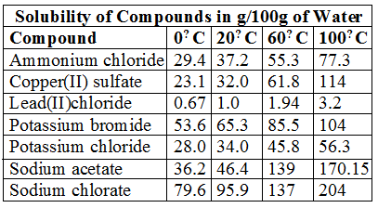
Solubility Curve and Table
A solubility graph like the one shown above is a graph where the lines graphed are representative of the solubility of various compounds.
can use these graphs to find the solubility of an element at certain temperatures in one hundred grams of water.
can also use it to determine if a solution is unsaturated, saturated, or super-saturated

Slide 7
Reading Solubility Charts
If the number in the problem is EQUAL to the value on the chart/graph the solution is considered SATURATED
If the number in the problem is LESS than the value on the chart/graph the solution is considered UNSATURATED
If the number in the problem is MORE than the value on the chart/graph the solution is considered SUPER SATURATED
Most charts/graphs are based on 100 g water. If water is doubled or tripled than the amount of salt is doubled or tripled

Slide 8
Reading Solubility Charts
Classify each as saturated, unsaturated or super saturated
40 g NaCl at 60°C
  Above line = super saturated
10 g KClO₃ at 30°C
  On line = saturated
51 g KCl at 90°C
  Below line = unsaturated
80 g NaNO₃ at 10°C
  On line = saturated
80 g CaCl₂ at 20°C
  Above line = super saturated

Slide 9
Reading Solubility Charts
How many grams of NaCl would be needed to make a saturated solution with 200 g of water at 40°C
What mass of water would be necessary to make a saturated solution containing 15 g KClO₃ at 70°C
What is the maximum temperature where a 45g KCl solution in 100 g water would be considered supersaturated?
36 g NaCl per 100 g water.
So 72 g NaCl for 200 g water
30 g KClO₃ per 100 g water. 15 g ONLY needs 50 g water.
Approx. 60 °C is saturated point. So 59 °C it would be super saturated

Slide 10

Molarity
Molarity (M) is the number of moles of solute dissolved in one liter of solution
A measurement of the concentration of solute to solvent in a solution.
To calculate the molarity of a solution, divide the moles of solute by the volume of the solution.
Molarity is also known as molar concentration

Slide 11
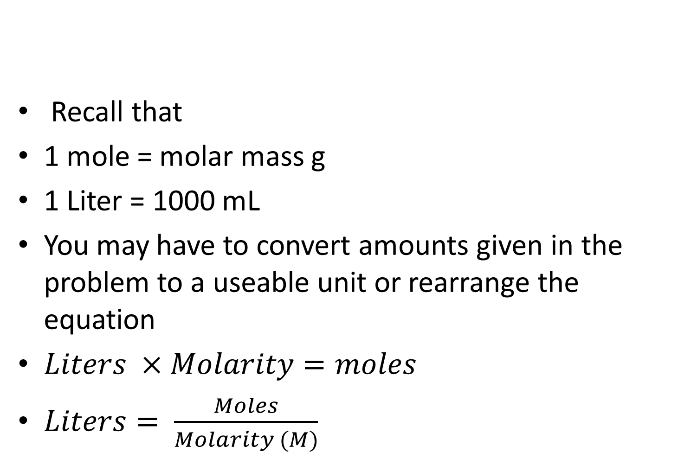
Molarity
Recall that
1 mole = molar mass g
1 Liter = 1000 mL
You may have to convert amounts given in the problem to a useable unit or rearrange the equation
$Liters ×Molarity=moles$
$Liters= \frac{Moles}{Molarity (M)}$

Slide 12



Molarity Example 1
A saline solution contains 0.95 g NaCl in exactly 100 mL of solution. What is the molarity of the solution?
  Need moles of solute, so turn grams to moles
  0.95 g NaCl x _________
  Need liters of solution
  100 ml x ______
  Molarity =
= 0.016 mol NaCl
= 0.100 L
= 0.16 M NaCl

Slide 13

Molarity Example 2
A solution has a volume of 2.50 L and contains 159g NaCl. What is the molarity of the solution?
  Need moles of solute, so turn grams to moles
  0159 g NaCl x _________
  Molarity =
= 2.72 mol NaCl
= 1.09 M NaCl

Slide 14

Molarity Example 3
What mass of NaCl is needed to make a 2.25 M NaCl solution with a volume of 500 mL?
  Need liters of solution
  500 ml x ______
  Molarity x Liters = moles
  2.25 M NaCl x 0.500 L = 1.13 mol NaCl
  Turn mole to grams
  1.13 mol NaCl x
= 0.500 L
= 66.0 g NaCl

Slide 15
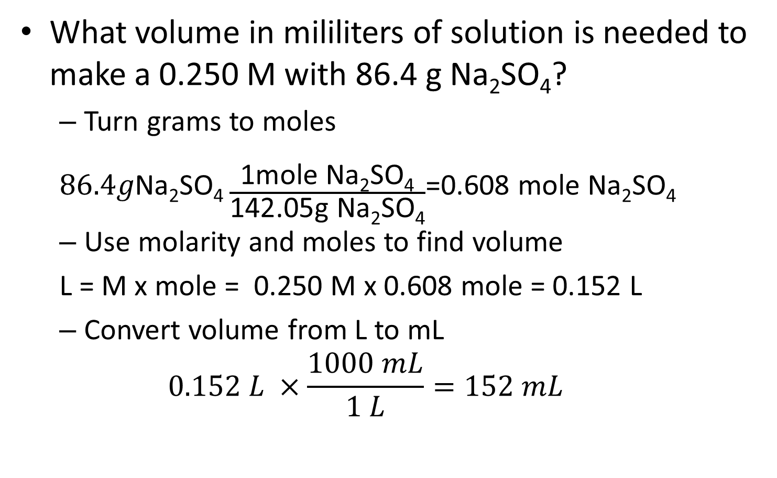
Molarity Example 4
What volume in mililiters of solution is needed to make a 0.250 M with 86.4 g Na₂SO₄?
  Turn grams to moles
  $86.4g\text{Na}\text{2}\text{SO}\text{4}\frac{\text{1}\text{mole} \text{Na}\text{2}\text{SO}\text{4}}{\text{142.05}\text{g} \text{Na}\text{2}\text{SO}\text{4}}$=0.608 mole $\text{Na}\text{2}\text{SO}\text{4}$
  Use molarity and moles to find volume
  L = M x mole = 0.250 M x 0.608 mole = 0.152 L
  Convert volume from L to mL
  $$0.152 L ×\frac{1000 mL}{1 L}=152 mL$$

Slide 16
Unit 10
Acids, Bases, and Salts
Chapter 19

Slide 17
19.1 Acid- Base Theories
Properties of Acids
  Taste sour
  React with metals to form H₂ gas
  Turns blue litmus paper RED
Properties of Bases
  Taste bitter
  feel slippery
  Turns red litmus paper BLUE
BOTH
  Can be strong or weak electrolytes in aqueous solutions
  React with the other to produce salt (an ionic compound) and water
  Are corrosive
  Change the color of indicators

Slide 18
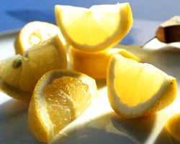
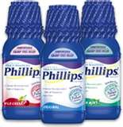
Examples
Acid: citric acid
Base: milk of magnesia
Magnesium hydroxide

Slide 19
Types of acids
Monoprotic acids are acids that contain one ionizable hydrogen.
  Nitric acid: HNO₃
Diprotic acids are acids that contain two ionizable hydrogens.
Sulfuric acid: H₂SO₄
Triprotic acids are acids that contain three ionizable hydrogens.
Phosphoric acid: H₃PO₄

Slide 20
Arrhenius Acids and Bases
Svante Arrhenius in1887 posed a way of defining acids and bases
Arrhenius Acids
  Are hydrogen-containing compounds that ionize to yield hydrogen ions (H+) [H+ producer]
  HCl + H₂O → H₃O⁺ + Cl⁻
Arrhenius Bases
  Are compounds that ionize to yield hydroxide ions (OH⁻) in aqueous solutions. [OH⁻ producer]
  NH₃ + H₂O → NH₄⁺ + OH⁻
  Arrhenius definiton incoporates the FEWEST number of compunds

Slide 21
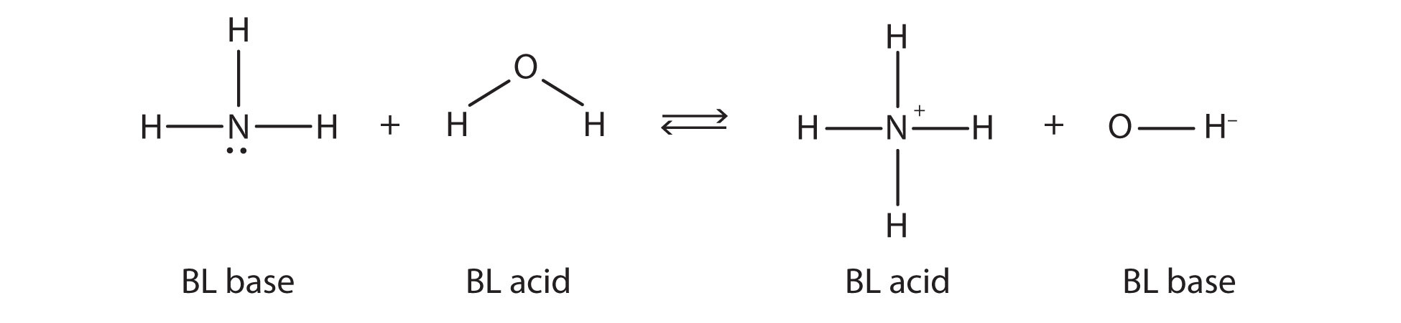
Brønsted-Lowry Acids and Bases
In 1923 Johannes Brønsted and Thomas Lowry proposed a new definition
Is a more comprehensive definition of acids and bases
Brønsted-Lowry Acids
  Is a hydrogen-ion donor
Brønsted-Lowry Bases
  Is a hydrogen-ion acceptor

Slide 22
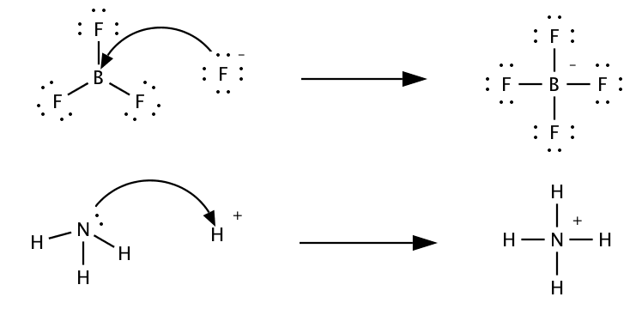
Lewis Acids and Bases
Gilbert Lewis’s theory of acids and bases was an extension of his concept of electron pairs
This is the broadest acid/base definition used.
Lewis acids accepts a pair of electrons
Lewis bases donate a pair of electrons
Acid
Base

Slide 23
Acid-Base Definitions
Type | Acid | Base
Arrhenius (smallest definition)
Brønsted-Lowry
Lewis (broadest definition)
H⁺ producer
OH⁻ producer
H⁺ donor
H⁺ acceptor
Electron-pair acceptor
Electron pair donor

Slide 24
4-20-17 Opener
 | Acids | Bases
Contain | Most start w/ Hydrogen | Most end with OH
pH | Below 7 | Above 7
taste | Sour | Bitter
Feel | Wet (like water) | Slippery
Turn litmus paper | Red | Blue
Example | Citric acid (lemons) HCl –stomach acid | Ammonia Bleach Ca(OH)₂
Properties of both | 1. Are weak or strong electrolytes 2. Are corrosive Change the color of indicators React with the other to produce salt (ionic compound) and water

Slide 25
Conjugate Acids and Bases
Conjugate acid is the particle formed when a base gains a hydrogen ion.
Conjugate base is the particle formed when an acid has donated a hydrogen ion.
Conjugate acid-base pair consists of two substance related by the loss or gain of a single hydrogen ion.
When a water molecule gains a hydrogen ion it becomes a positively charged hydronium ion (H₃O⁺).
When water molecule looses a hydrogn ion it becomes the negativly charged hydroxide ion (OH⁻¹)

Slide 26
Conjugate Acid and Bases
HCl + H₂O → H₃O⁺ + Cl⁻
Acid + Base → Conjugate + Conjugate
Acid Base
NH₃ + H₂O → NH₄⁺ + OH⁻
Base + Acid → Conjugate + Conjugate
Acid Base
A substance that can act as both an acid and a base is said to be amphoteric. (example: Water )

Slide 27
Conjugate acids and base
When an acid forms a conjugate base the formula changes by
  Subtracting an H and adding -1 charge
  Example: HCl and Cl⁻
When a base forms a conjugate acid the formula changes by
  Adding an H and adding +1 charge
  Example: NH₃ and NH₄⁺¹
Water can be both an acid or a base depending on what is added
  Acid: H₂O to the conjugate base: OH⁻
  Base: H₂O to the conjugate acid: H₃O⁺

Slide 28
Conjugate acids and base
What are the conjugate bases of these acids?
HClO₄ b) HSO₄^{–1} c) HC₂H₃O₂ d) H₂S
a) ClO₄ ^{–1} b) SO₄^{–2} c) C₂H₃O₂ ^{–1} d) HS ^{–1}
What are the conjugate acids of these bases
SO₄^{–2} b) NH₃ c) F^{–1} d) HPO₃^{–2}
a) HSO₄^{–1} b) NH₄⁺¹ c) HF d) H₂PO₃⁻¹

Slide 29
Conjugate Acid-Base Pairs Practice
1. HCl + NH₃ → NH₄⁺¹ + Cl^{–1}
acid base c. acid c. base
2. OH^{–1} + HCN → H₂O + CN^{–1}
base acid c. acid c. base
3. PO₄^{–3} + HNO₃ → NO₃^{–1} + HPO₄^{–2}
base acid c. base c. acid
4. HCO₃^{–1} + HCl → H₂CO₃ + Cl^{–1}
base acid c. acid c. base
HClO₃ + OH⁻ → H₂O + ClO₃⁻
acid bade c. acid c. base

Slide 30
19.1 Review
What are the properties of acids and bases?
How did Arrhenius define and acid and base?
How are acids and bases defined by the Brønsted-Lowry theory?
What is the Lewis-theory of acids and bases?
Identify the following as monoprotic, diprotic or triprotic:
a) H₂CO₃ b) H₃PO₄ c) HCl d) H₂SO₄

Slide 31
19.1 Review
See slide #25 (opener from 4/20)
Arrhenius acid produced H+, base produced OH-
Brønsted-Lowry acid H+ donor, base H+ acceptor
Lewis-theory of acids electron pair acceptor, base is electron pair donor.
Identify the following as monoprotic, diprotic or triprotic:
a) H₂CO₃ b) H₃PO₄ c) HCl d) H₂SO₄
diprotic Triprotic Monoprotic diprotic

Slide 32
The pH Concept
The pH of a solution is the negative logarithm of the hydrogen-ion concentration.
pH = - log [H⁺]
For example a neutral solution has [H⁺] of 1.0 x 10 ⁻⁷ so the pH is calculated
pH = -log (1.0 x 10 ⁻⁷ ) = 7.00
The pOH of a solution is the negative logarithm of the hydroxide concentration.
pOH = - log [OH⁻¹]

Slide 33
Calculating pH practice
[H⁺] of 1.0 x 10 ⁻¹¹
  pH = -log (1.0 x 10 ⁻¹¹ ) = 11.00
[H⁺] of 6.0 x 10 ⁻⁵
  pH = -log (6.0 x 10 ⁻⁵ ) = 4.22
[H⁺] of 4.0 x 10 ⁻³
  pH = -log (4.0 x 10 ⁻³ ) = 2.40
[H⁺] of 9.0 x 10 ⁻⁹
  pH = -log (9.0 x 10 ⁻⁹ ) = 8.05

Slide 34
Calculating pOH
pOH = - log [OH⁻]
[OH⁻] of 1.0 x 10 ⁻³
  pOH = -log (1.0 x 10 ⁻³ ) = 3.00
[OH⁻] of 6.0 x 10 ⁻⁷
  pOH = -log (6.0 x 10 ⁻⁷ ) = 6.22
[OH⁻] of 2.0 x 10 ⁻⁴
  pOH = -log (2.0 x 10 ⁻⁴ ) = 3.70
[OH⁻] of 7.2 x 10 ⁻⁹
  pOH = -log (7.2 x 10 ⁻⁹ ) = .14

Slide 35
A solution in which [H⁺] is greater than 1.0 x 10 ⁻⁷ has a pH less than 7.0 and is acidic.
The pH of a neutral solution is 7.0
A solution in which [H⁺] is less than 1.0 x 10 ⁻⁷ has a pH greater than 7.0 and is basic.
A simple relationship between pH and pOH allows you to calculate the other if one is known.
pH + pOH = 14

Slide 36
Calculating concentration from pH/pOH
Using pH to find [H⁺] since pH= -log [H⁺]
Then [H⁺] = 10^{(-pH)}
Calculate the [H+] for the solution
pH= 3.00
[H⁺]= 10^{(-pH)} [H⁺] = 10^{(-3.00)} = 1.0 x 10⁻³ M H⁺
0.00100 M H⁺
Using pH to find [OH⁻¹] since pOH= -log [OH⁻¹]
Then [OH⁻¹] = 10^{(-pOH)}
Calculate the [OH⁻¹] for the solution
pOH= 7.67
[OH⁻¹]= 10^{(-pOH)} [OH⁻¹] = 10^{(-7.67)} = 2.14 x 10⁻⁸

Slide 37
pH to pOH
If [H⁺¹] is 2.5 x 10⁻⁴ what is the pOH
  pH = -log [2.5 x 10⁻⁴ ] =
  pOH = 14 – 3.60 =
If the [OH-1] is 6.8 x 10⁻¹² what is the pH
  pOH = -log [6.8 x 10⁻¹² ] =
  pH = 14 – 11.17 =
3.60
10.40
11.17
2.83

Slide 38
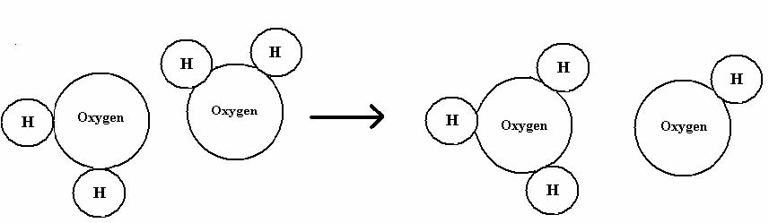
19.2 Hydrogen Ions and Acidity
The reaction in which water molecules produce ions is called the self-ionization of water
H₂O(l) H⁺(aq) + OH⁻(aq)
2H₂O(l) H³O⁺(aq) + OH⁻(aq)

Slide 39
Self-ionization of water occurs to a very small extent, in pure water at 25°C.
Any aqueous solution in which the [H⁺] and [OH⁻] are equal is called a neutral solution.
In aqueous solution [H⁺] x [OH⁻] = 1.0 x 10⁻¹⁴
  This is called the ion-product constant for water (K_{w}).
  The concentrations may change but the product always equals 1.0 x 10⁻¹⁴ for water.

Slide 40
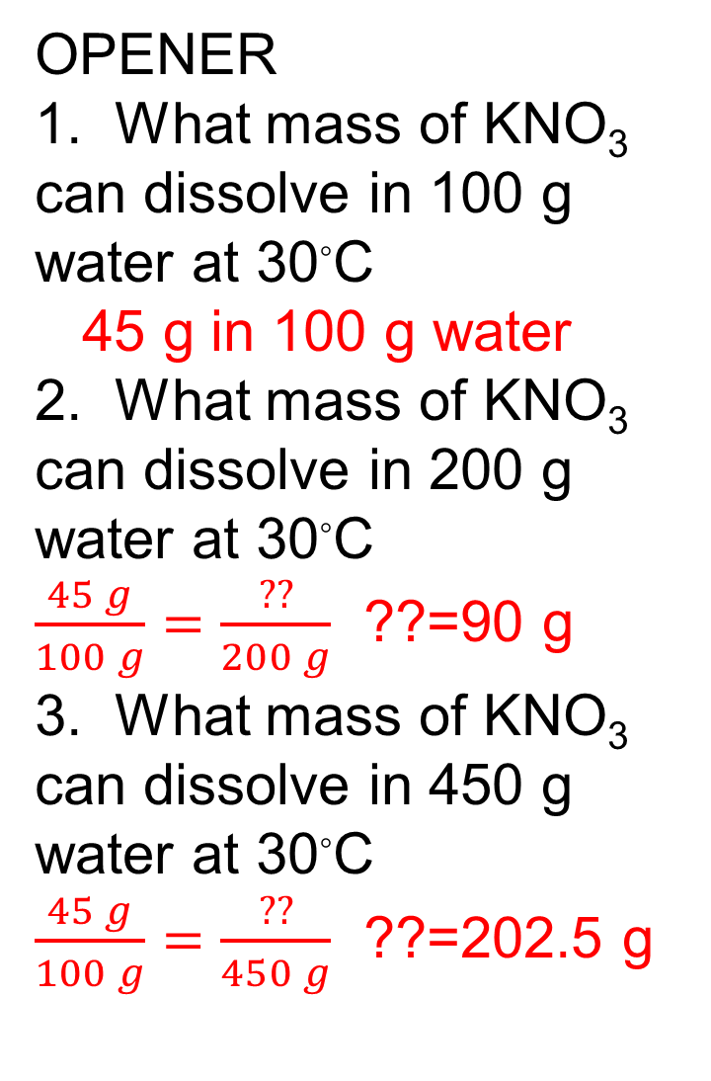
OPENER
1. What mass of KNO₃ can dissolve in 100 g water at 30◦C
45 g in 100 g water
2. What mass of KNO₃ can dissolve in 200 g water at 30◦C
$\frac{45 g}{100 g}=\frac{??}{200 g}$ ??=90 g
3. What mass of KNO₃ can dissolve in 450 g water at 30◦C
$\frac{45 g}{100 g}=\frac{??}{450 g}$ ??=202.5 g

Slide 41

Acidic Solutions
An acidic solution is one in which the [H⁺] is greater than the [OH⁻].
The [H⁺] of an acidic solution is greater than 1.0 x 10⁻⁷ M
  HCl_{(g)} H⁺ _{(aq)} + Cl⁻ _{(aq)}

Slide 42
Basic Solution
An basic solution is one in which the [H⁺] is less than the [OH⁻].
The [H⁺] of an acidic solution is less than 1.0 x 10⁻⁷ M
NaOH Na⁺ + OH⁻
Basic solutions are also known as alkaline solutions.

Slide 43
What is the [H⁺] of a solution with a pOH of 3.12? Is it acidic, basic, or neutral?
pH= 14- pOH pH= 14 – 3.12 = 10.88
[H⁺]= 10^{(-pH)} [H⁺] = 10^{(-10.88)} = 1.3 x 10⁻¹¹
it is a Basic solution
What is the [H⁺] of a solution with a pOH of 9.18? Is it acidic, basic, or neutral?
pH= 14- pOH pH= 14 – 9.18 = 4.82
[H⁺]= 10^{(-pH)} [H⁺] = 10^{(-4.82)} = 1.5 x 10⁻⁵
it is an acidic solution

Slide 44
Example: What is the [OH⁻] if the [H⁺] is 1.0 x 10 ⁻³?
remember: [OH⁻] x [H⁺] = 1.0 x 10 ⁻¹⁴
[OH⁻] = 1.0 x 10 ⁻¹⁴/ 1.0 x 10 ⁻³= 1.0 x 10 ⁻¹¹
Possible equations
pH = -log [H⁺¹] pOH = -log [OH⁻¹] pH + pOH =14
[H⁺¹] = 10^{-pH} [OH⁻¹] = 10^{-pOH} [H⁺¹]x[OH⁻¹]=10⁻¹⁴
Classify each solution as acidic, basic, or neutral:
[H⁺] = 6.0 x 10 ⁻¹⁰
[OH⁻] = 3.0 x 10 ⁻⁴
[H⁺] = 6.0 x 10 ⁻⁷
[H⁺] = 1.0 x 10 ⁻⁷

Slide 45
Concentration to pH and back
Possible equations
pH = -log [H⁺¹] pOH = -log [OH⁻¹] pH + pOH =14
[H⁺¹] = 10^{-pH} [OH⁻¹] = 10^{-pOH} [H⁺¹]x[OH⁻¹]=10⁻¹⁴
If the [OH⁻¹] = 4.68 x 10⁻³ determine the pOH, pH, [H⁺¹] and if acidic/basic/neutral.
pOH
pH
[H⁺¹]
Substance is
= - log [4.68 x 10⁻³ ]
= 2.33
= 14-2.33
= 11.67
=10 ^{-11.67}
= 2.14 x 10⁻¹²
Basic because pH is 11.67

Slide 46
Strength of Acids & Bases
What does it mean to be a STRONG acid?
What are the 6 strong acids? (name and formula)
What does it mean to be a STRONG base?
What are the 8 strong bases? (name and formula)
What does it mean to be a WEAK acid or WEAK base?

Slide 47
19.3 Strengths of Acids and Bases
Strong acids are completely ionized in aqueous solutions.
HCl_{(aq)} + H₂O_{(l)} →H₃O⁺_{(aq)} + Cl⁻_{(aq)} 100% ionized
Weak acids only slightly ionize in aqueous solutions.
CH₃COOH_{(aq)} + H₂O_{(l)} H₃O⁺_{(aq)} + CH₃COO⁻_{(aq)}
Less than 0.4% ionized

Slide 48
Six strong acids!!
HCl hydrochloric acid
HBr hydrobromic acid
HI hydroiodic acid
HNO₃ nitric acid
H₂SO₄ sulfuric acid
HClO₄ perchloric acid
All other acids are considered weak acids!!

Slide 49
Base Dissociation Constant
Strong bases dissociate completely into metal ions and hydroxide ions in aqueous solution.
NaOH → Na⁺ + OH⁻
Weak bases react only partially ionized in water to form the hydroxide ion and the conjugate acid of the base.
NH_{3(aq)} + H₂0_{(l)} NH₄⁺_{(aq)} + OH⁻_{(aq)}

Slide 50
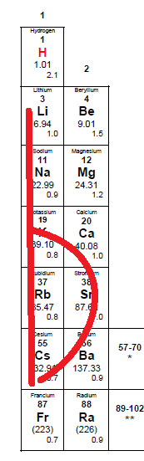
Eight strong bases
LiOH - lithium hydroxide
NaOH - sodium hydroxide
KOH - potassium hydroxide
RbOH - rubidium hydroxide
CsOH - cesium hydroxide
Ca(OH)₂ - calcium hydroxide
Sr(OH)₂ - strontium hydroxide
Ba(OH)₂ - barium hydroxide
  Metals make a lower case b on the periodic table

Slide 51
Strong Acids or Bases
[H⁺] for strong acids equals molarity of acid
[H⁺]= M of acid so pH=-log [acid M]
[OH⁻] for strong bases equals molarity of base
[OH-]= M of base so pOH=-log [base M]
What is the pH and pOH for the following solutions
0.275 M HCl
0.500 M NaOH
0.200 M HNO₃
0.375 M Ba(OH)₂

Slide 52
pH and pOH of Strong Acids and Bases
0.275 M HCl
  pH = -log (0.275) =0.561
  pOH = 14 – 0.561 = 13.439
0.500 M NaOH
  pOH = - log (0.50) = 0.30
  pH = 14 – 0.30 = 13.70
0.200 M HNO₃
  pH = -log (0.20) =0.70
  pOH = 14 – 0.70 = 13.30
0.375 M Ba(OH)₂
  pOH = - log (0.375) = 0.426
  pH = 14 – 0.426 = 13.574

Slide 53
19.4 Neutralization Reactions
When you mix a strong acid with a strong base a neutral solution results.
HCl _{(aq)} + NaOH _{(aq)} →NaCl _{(aq)} + H₂O _{(l)}
2 HBr _{(aq)} + Ba(OH)_{2 (aq)} → BaBr_{2(aq)} + 2 H₂O _{(l)}
A neutralization reaction is where an acid and a base react to form a salt and water

Slide 54
Titration
The process of adding a known amount of a solution of known concentration to determine the concentration of another solution is called titration.
The solution of known concentration is called the standard solution.
We use a burett to add the standard solution.
Acids and bases do not always react in a 1:1 ratio

Slide 55
The solution is added until the indicator changes colors.
The point at which the indicator changes colors is the end point of the titration.
The equivalence point is when the number of moles of hydrogen ions equals the number of moles of hydroxide ions.

Slide 56
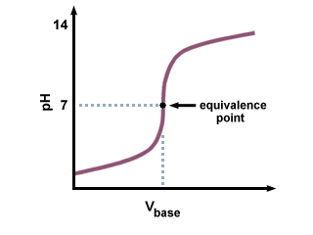
Titration of a strong acid with a strong base

Slide 57
19.5 Salts in Solution
A salt consists of an anion from an acid and a cation from a base. It forms as the result of a neutralization reaction.
A buffer is a solution in which the pH remains relatively constant when small amount of acid or base are added.
A buffer is a solution of a weak acid and one of its salts, or a solution of a weak base and one of its salts.
Buffers are able to resist drastic changes in pH.

Slide 58
19.5
Salt hydrolysis the cations or anions of a dissociated salt remove hydrogen ions from or donate hydrogen ions to the water.
In general, salts that produce acidic solutions contain positive ions that release protons to water
Salts that produce basic solutions contain negative ions that attract protons from water.

Slide 59
The buffering capacity is the amount of acid or base that can be added to a buffer solution before a significant change in pH occurs.
Buffer systems are crucial in maintaining human blood pH within a narrow range.

Slide 60
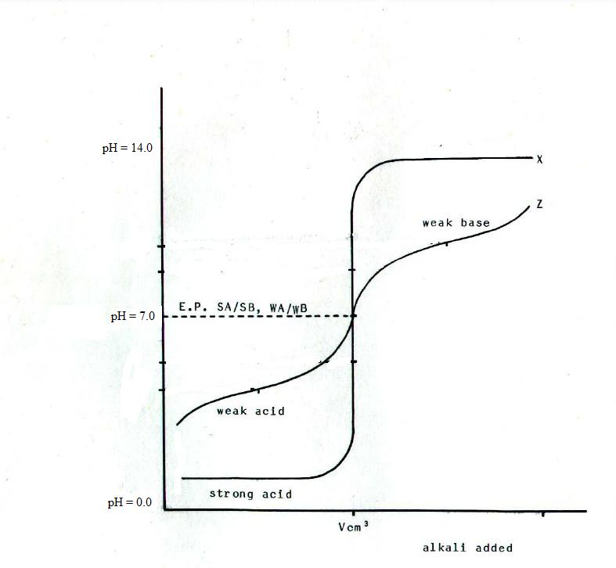

Slide 61
Acid/Base Quiz 1
Quiz A
A
D
C
D
D
A
A
B
---
pH = 14 - 4.56 =9.44
[H+] = 10^{-9.44}= 3.63 x 10⁻¹⁰
Base
11. pOH = -log (2.34 x 10⁻¹¹) = 10.63
pH = 14 - 10.63 =3.37
Acid

Slide 62
Acid/Base Quiz 1
Quiz B
D
D
A
B
A
---
A
D
C
11. pOH = -log (4.78 x 10⁻¹²) = 11.81
pH = 14 – 11.81 = 2.68
Acid
pH = 14 – 2.19 =11.81
[H+] = 10^{-11.81}= 1.55 x 10⁻¹²
Base

Slide 63
Titration Calculations – 1st type of problem
write a balanced chemical equation
    remember to balance charges before writing chemical formulas
determine the number of moles of known reactant available (use Molarity)
use stoichiometry to calculate the number of moles of unknown reactant needed (mole ratio)
use molarity to determine the number of mL needed to complete the neutralization.

Slide 64
Determine the volume of 2.1 M sodium hydroxide needed to titrate 435 mL of 1.75 M sulfuric acid.
1st : 2NaOH + H₂SO₄ → Na₂SO₄ +2H₂O
2nd : 0.435L x [1.75 mol/1L]= 0.76125 mol H₂SO₄
3rd: 0.76125mol H₂SO₄ x 2mol NaOH = 1.5225 mol NaOH
1 mol H₂SO₄
4th : 1.5225 mol NaOH x __1 L = 0.725 L = 725 ml
2.1 mol

Slide 65
Determine the volume of 3.3 M hydrochloric acid needed to titrate 355 mL of 2.50 M magnesium hydroxide .
1st : 2HCl + Mg(OH)₂ → MgCl₂ +2H₂O
2nd : 0.355L x [2.50 mol/1L]= 0.8875 mol Mg(OH)₂
3rd: 0.8875mol Mg(OH)₂ x 2mol HCl = 1.775 mol HCL
1 mol Mg(OH)₂
4th : 1.775mol HCl x __1 L = 0.538 L = 538 ml HCl
3.3 mol

Slide 66
Titration Calculations – 2nd type of problem
write a balanced chemical equation
    remember to balance charges before writing chemical formulas
determine the number of moles of known reactant available (use Molarity)
use stoichiometry to calculate the number of moles of unknown reactant needed (mole ratio)
use moles and volume to determine the Molarity of unknown reactant

Slide 67
Titration Calculations – 2nd type of problem
Titration reveals that 22.5 ml of 2.0 M nitric acid are required to neutralize 20 ml of calcium hydroxide. What is the molarity of the calcium hydroxide?
1st : 2HNO₃ + Ca(OH)₂ → Ca(NO₃)₂ +2H₂O
2nd : 0.0225L x [2.0 mol/1L]= 0.045 mol HNO₃
3rd: 0.045mol HNO₃ x 1mol Ca(OH)₂ = 0.0225 mol Ca(OH)₂
2 mol HNO₃
4th : 0.0225mol Ca(OH)₂ = 1.125 M Ca(OH)₂
0.020 L

Slide 68
Titration reveals that 11.2 ml of 3.5 M barium hydroxide are required to neutralize 50 ml of perchloric acid. What is the molarity of the perchloric acid?
1st : 2HClO₄ + Ba(OH)₂ → Ba(ClO₄)₂ +2H₂O
2nd : 0.0112L x [3.5 mol/1L]= 0.0392 mol Ba(OH)₂
3rd: 0.0392mol Ba(OH)₂ x 2 mol HClO₄ = 0.0784 mol HClO₄
1 mol Ba(OH)₂
4th : 0.0784 mol HClO₄ = 1.56 M HClO₄
0.050 L

